Slide 1
Interactions 2
More energy loss, electrons

Slide 2



























Slide 3

























Slide 4




























Slide 5



































Slide 6
































Slide 7










































Slide 8






















Slide 9






















Slide 10
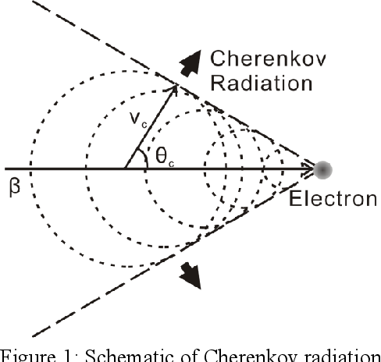
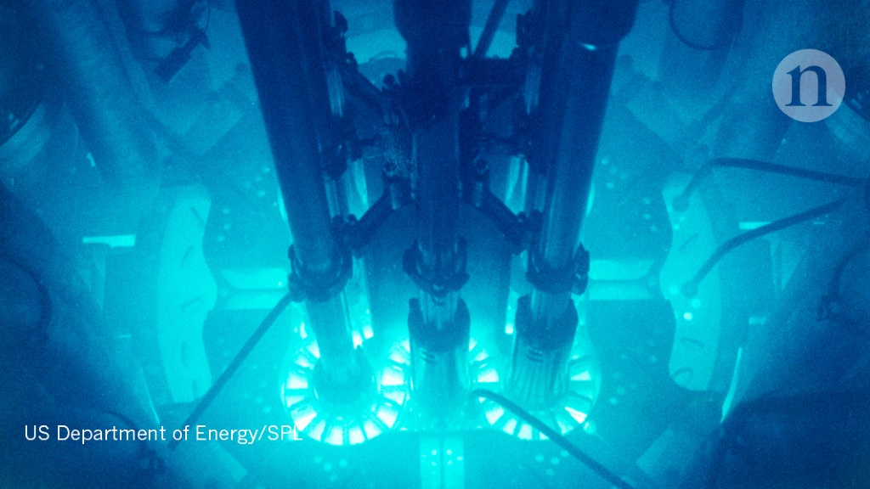






































Slide 11





















Slide 12









































Slide 13









